Slide 1

OPTIMAL PRICING OF PRODUCTS Apparel Industry

Slide 2
Industry Background and Client
American Fashion Retailer for women
Over 700 stores across the US.
Value Fashion segment - wear-to-work affordable clothing
CFO believes finding an optimal price point for every SKU will drive higher top line and bottom line benefit.
He is going to use the results of this project and convince the merchants to better price the products.

Slide 3
PROBLEM STATEMENT AND OUTCOME
OUTCOME
What should be the price at which the products (class / group of products) should be sold?
2. What factors define and drive prices of products?
Optimal price of sale given a product/group of products along with its confidence interval.
The impact of variation in variables on pricing should also be explained.
Visualisation of the outcome can be done on the tool of choice.

Slide 4
APPROACH
Project is divided into two parts:
Understand impact of various factors (variables) on the Sale Price and Profit
Sale Price Optimization for top line and bottom line growth

Slide 5
STEPS (CRISP-DM)
Data Understanding
Data Preparation
Exploratory Analytics
Modeling
Evaluation
Conclusion

Slide 6
Data Understanding
Dataset contains 3 datasets in CSV files:
Product Dataset
DBSKU
DEPARTMENT
CLASS
SUBCLASS
DEPARTMENT_NAME
CLASS_NAME
SUBCLASS_NAME
(29342, 7)
Transaction Dataset
DAY_DT
LOC_INDT
DBSKU
ONLINE_FLAG
FULL_PRICE_IND
TOTAL_SALES
TOTAL_UNITS
TOTAL_SALES_PRFT
TOTAL_COST
(13053149, 9)
Stores Dataset
LOC_IDNT
CITY
STATE
STORE_TYPE
POSTAL_CD
STORE_SIZE
(1303, 6)

Slide 7
Data Cleanup
Feature Reduction Removing insignificant columns such as product name Combine dependent columns into one (Prod class+subclass) Class is encoded into subclass
Handle null/missing values Impute with average, delete rows (depending on data)
Convert features to expected types
Remove Duplicates
Rename Columns for better understanding
Reduce Cardinality Reduce number of categories (such as for store_type)
Remove invalid values Such as -1 in state, negative Cost and Selling Price
Add columns meaningful for analysis (such as Cost Per Unit, S.P per unit)

Slide 8
Data Augmentation
Public Datasets
1) Gender ratio across States and Cities
2) Income ranges
Since this is Womens’ Apparel business for low-mid income market, above data might have correlation
Computed Features
1) is_weekend, computed from transaction date to find out if Sales (and profit) are impacted on weekends
2) season (winter/spring etc) to find out if season affects sales and profits

Slide 9
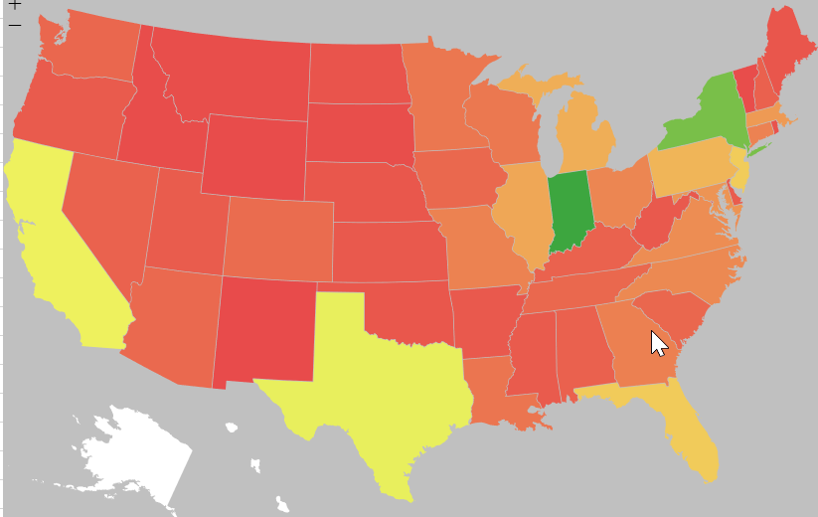
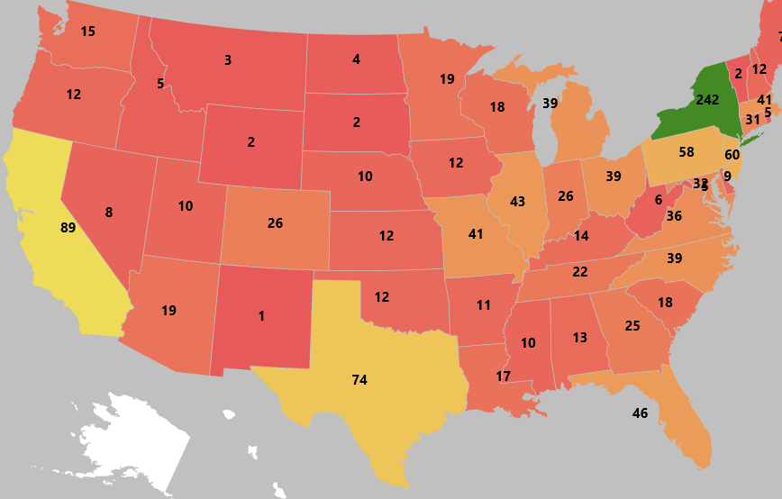
EXPLORATORY ANALYTICS - ACTIONABLE BUSINESS INSIGHTS
Geographic Distribution of Stores is not aligned with Sales and Profits
Suffern, NY has 152 stores.but Sales and Profits are 7X more in Greencastle, Indian
SALES DISTRIBUTION
STORES DISTRIBUTION
Consider opening more stores in Indiana

Slide 10
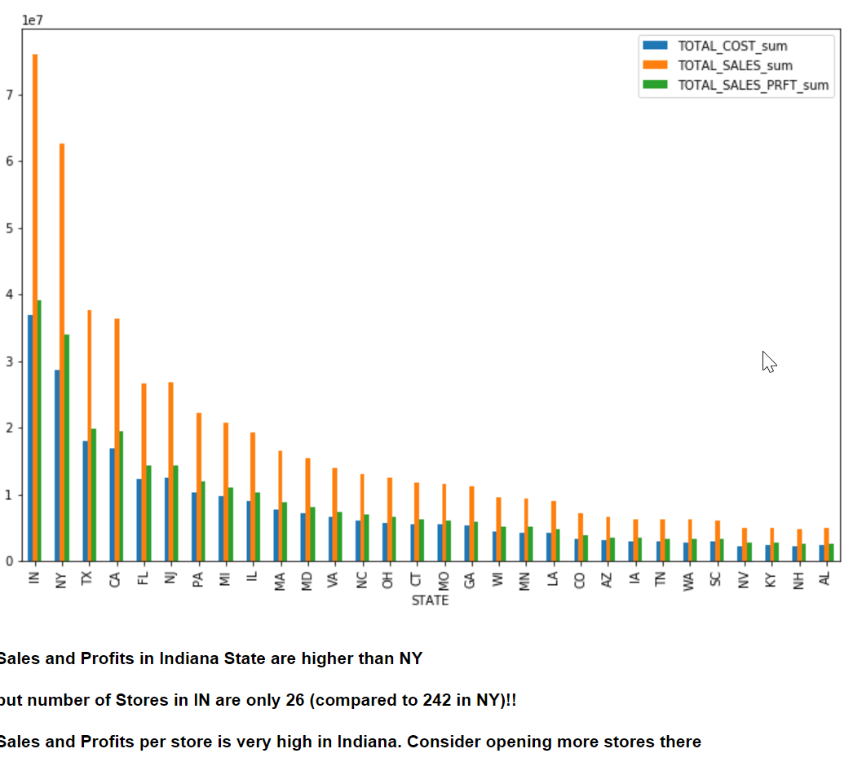
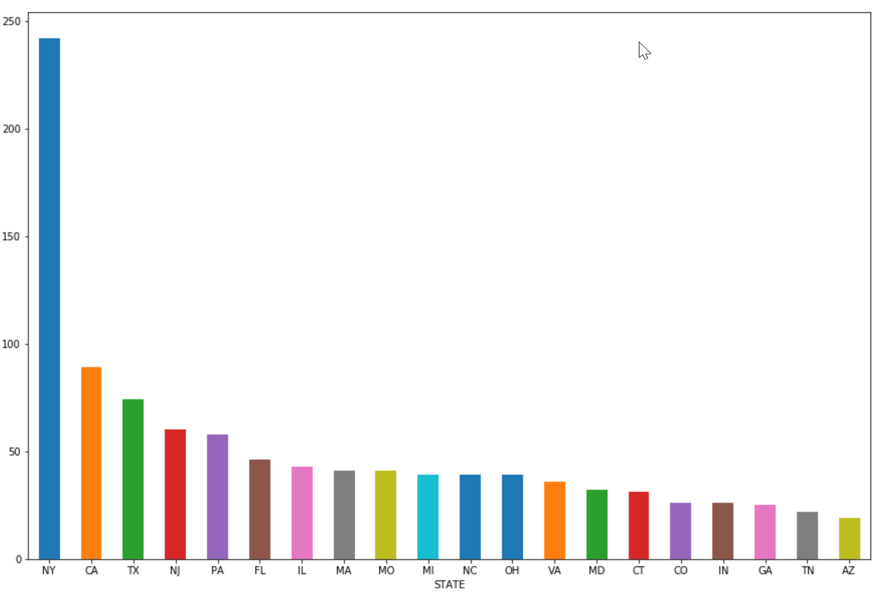
EXPLORATORY ANALYTICS - ACTIONABLE BUSINESS INSIGHTS
Geographic Distribution of Stores is not aligned with Sales and Profits
Suffern, NY has 152 stores.but Sales and Profits are 7X more in Greencastle, Indian
Consider opening more stores in Indiana

Slide 11
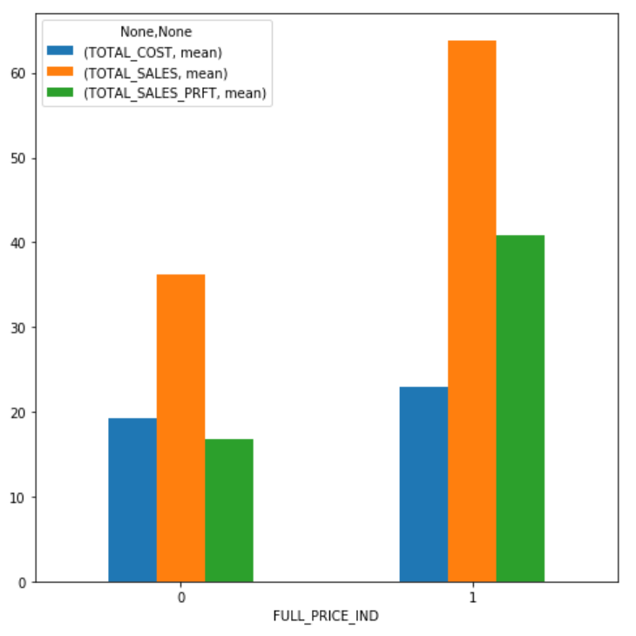
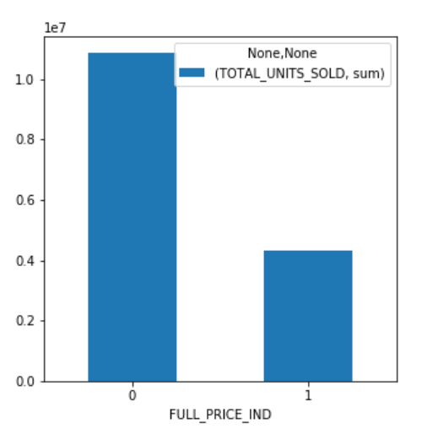
EXPLORATORY ANALYTICS - ACTIONABLE BUSINESS INSIGHTS
When selling at Full Price, number of units sold reduce by 2/3rd If inventory reduction is a goal, do not sell at Full Price
Total Sales and Profits High with FP.. BUT Total Units Sold are much less (almost 1/3rd)

Slide 12
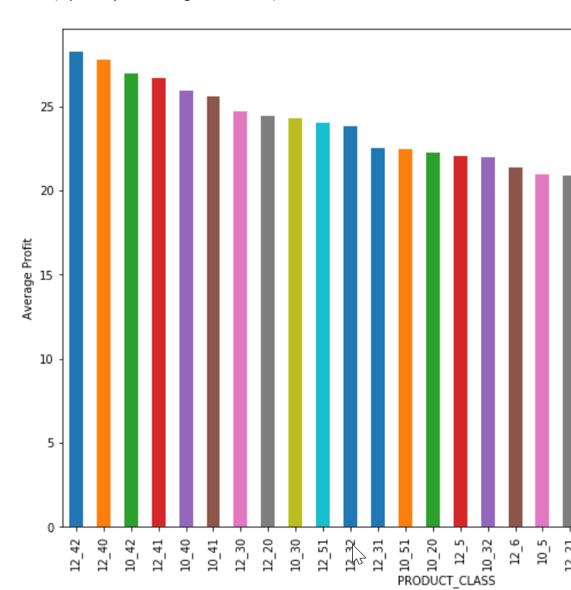
EXPLORATORY ANALYTICS - ACTIONABLE BUSINESS INSIGHTS
Product Class 4 is most profitable across both departments
Promotions should target products in Class 4 to maximize profits

Slide 13
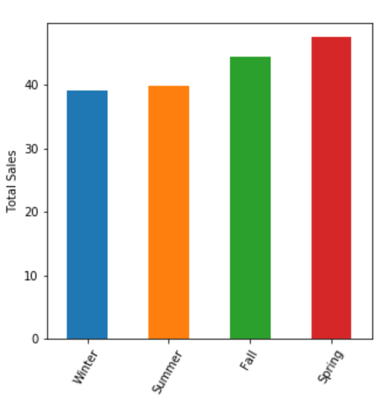
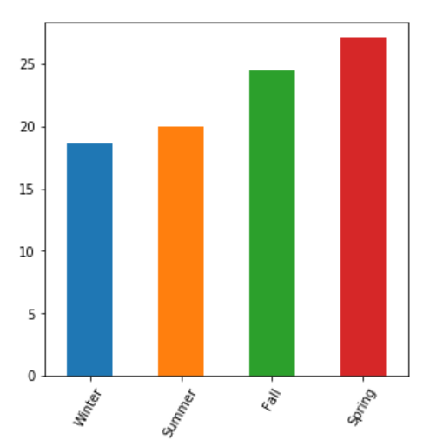
EXPLORATORY ANALYTICS - ACTIONABLE BUSINESS INSIGHTS
Profits are 25-30% higher in Fall and Spring season
Total Sales
Total Profits
Consider promotions just before start of Fall and Spring to maximise profits

Slide 14
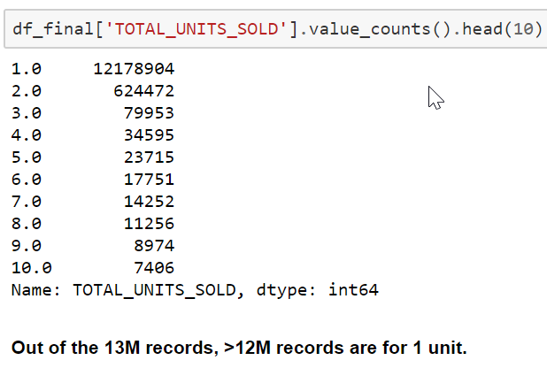
EXPLORATORY ANALYTICS - ACTIONABLE BUSINESS INSIGHTS
> 95% transactions are for ONLY ONE unit.
Easiest way to higher Sales would be to promote purchase of more than one unit (Customer is already there in the store!) - deals such as ‘Buy 1, get other 50% off'

Slide 15
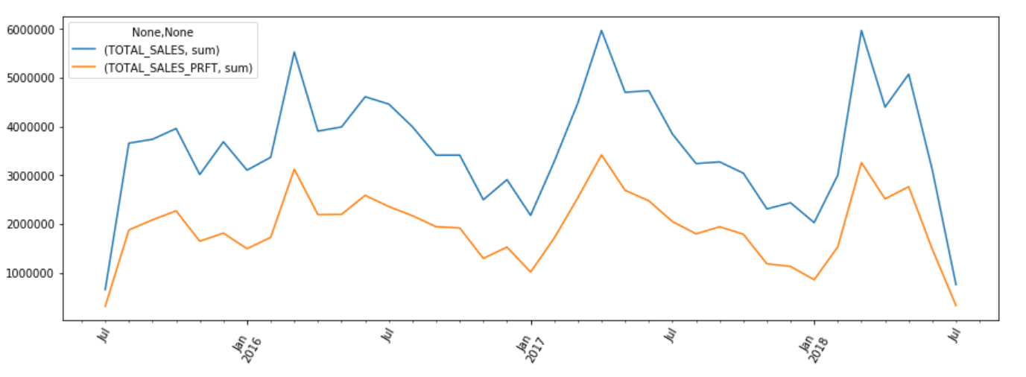
Sales over time - Consistently and Significantly higher sales every year in Mar/Apr
Profits are following exact same pattern as Sales
Target promotions and optimize profits, operations during those months

Slide 16
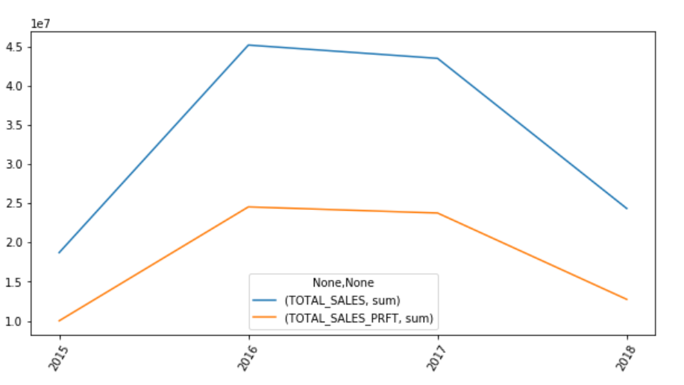
YoY Sales and Profits do not show much growth (they are slightly negative)
No Topline Growth
Growth Strategy needs to be looked into. Lay more emphasis on maximizing Sales instead of maximizing Profits for longer term growth
Note: For 2015 and 2018 only partial year data is available, hence the dips

Slide 17
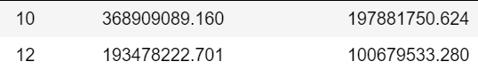
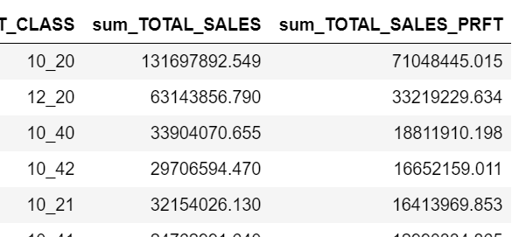
EXPLORATORY ANALYTICS - BUSINESS INSIGHTS
It is a high margin business Avg Selling Price is $37 with Avg Profit of $19 (~50%)
No significant impact of Holidays on Sales Perhaps as this is an affordable clothing segment
Sales (and Profits) from Department 10 are twice those from Dept 12
Subclass 20 in both departments has significantly higher sales and profits

Slide 18
EXPLORATORY ANALYTICS - BUSINESS INSIGHTS
Women employment rate did not have significant impact on Sales Women spend on clothes anyways? :)
SUBCLASS 5 across both departments had a huge spike in Sales in Feb/Mar 2016.
Sales are consistently high in Mar-Apr every year
No significant YoY improvement in Sales or Profit (they have reduced slightly)

Slide 19
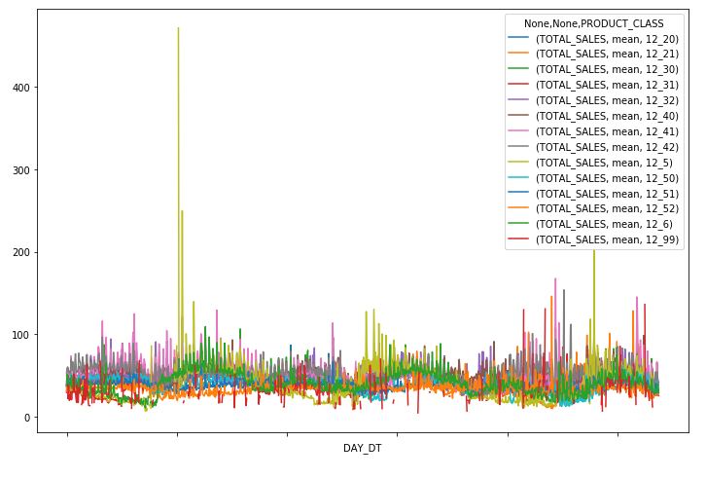
SUBCLASS 5 across both departments had a huge spike in Sales in Feb/Mar 2066. Other than that most sales are spread evenly across time.

Slide 20
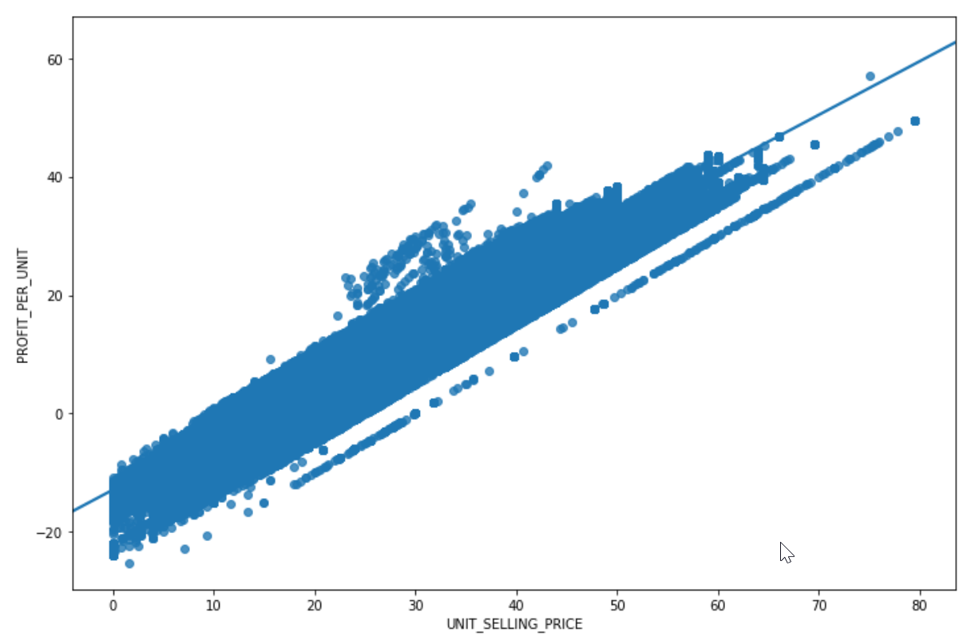
Relationship between Sale Price and Profit is linear (dept 10, subclass 20)

Slide 21
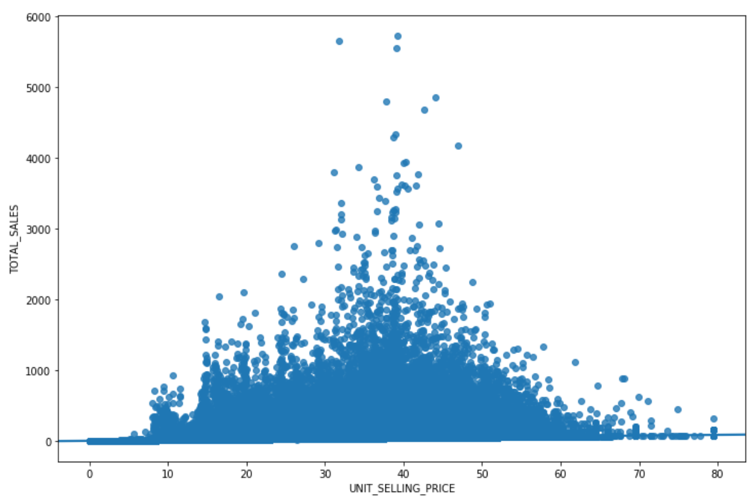
Beyond a certain Selling Price, Total Sales decrease (dept 10, subclass 20)
This can be used to determine Selling Price to maximise Revenue

Slide 22
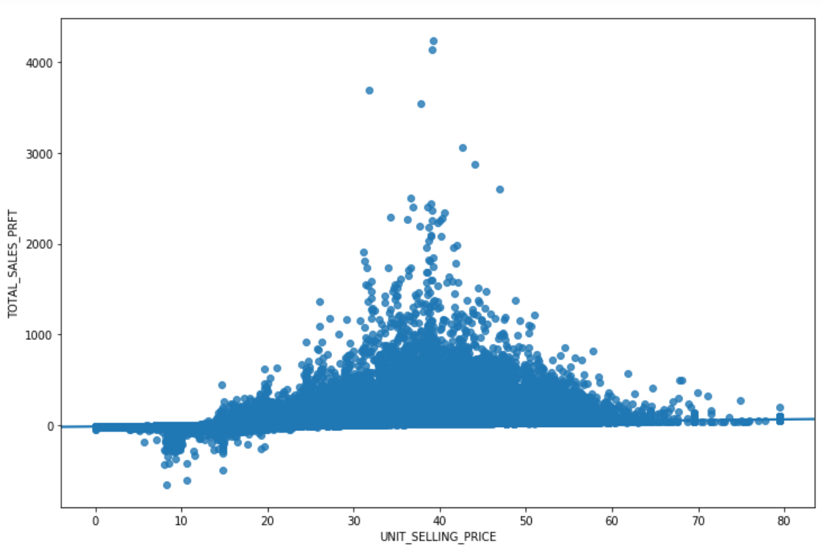
At low selling price, there are losses
After a certain point, higher selling price does not result in higher profit
Above can be used to determine price point to optimize profit and revenue

Slide 23
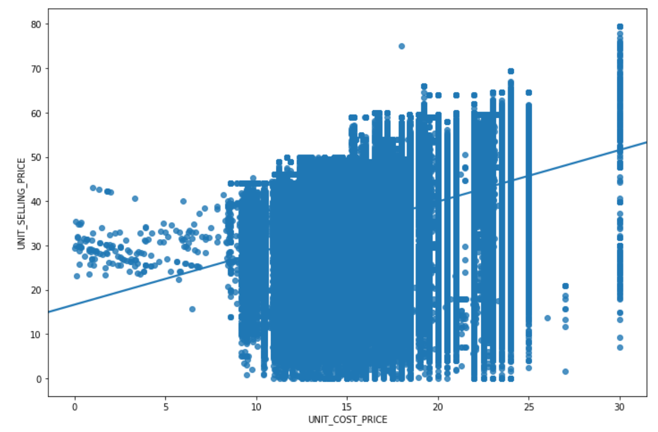
Cost Price has spread between 10 and 25
Selling Price has spread between 5 and 60
There is potential to explore cost price reduction and Selling Price increase

Slide 24
MODELLING
We need to predict the Sale Price.
Sale Price is a continuous variable, and model needs to be trained from existing data.
So we need to choose a Supervised Learning, Regression model
Choices in that category are:
Linear Regression
DecisionTreeRegressor
RandomForestRegressor
In addition, KNN (K-Nearest Neighbors) was explored to find out if clustering with nearest data points with similar features gives a more accurate result

Slide 25
MODELLING
Target variable is UNIT_SELLING_PRICE
The features that are of interest for modelling are as follows
ONLINE_FLAG
FULL_PRICE_IND
UNIT_COST_PRICE
UNIT_SELLING_PRICE [target]
TOTAL_UNITS_SOLD HOLIDAY
DEPARTMENT
SKU
STORE_SIZE
STORE_TYPE_MALL
STORE_TYPE_STRIP
STORE_TYPE_OTHER
PCNT_WOMEN_EMPLOYED
MEDIAN_HOUSEHLD_INCOME_BINS
SEASON
PRODUCT_CLASS

Slide 26
MODELLING - FEATURE ENGINEERING
One Hot encoding - create dummy variables
Feature Encoding - NFP/FP to 0 and 1
Feature Reduction - Remove unneeded columns
Filter to relevant data - for this project only profitable transactions are considered. A 20th percentile profit value of 40.8% is used as threshold All transactions that are below this threshold are not considered in the model
Note: Feature Scaling not needed as randomforest and decisiontree are primary algos and they are not ‘distance based’ (do not require Euclidian Square)

Slide 27
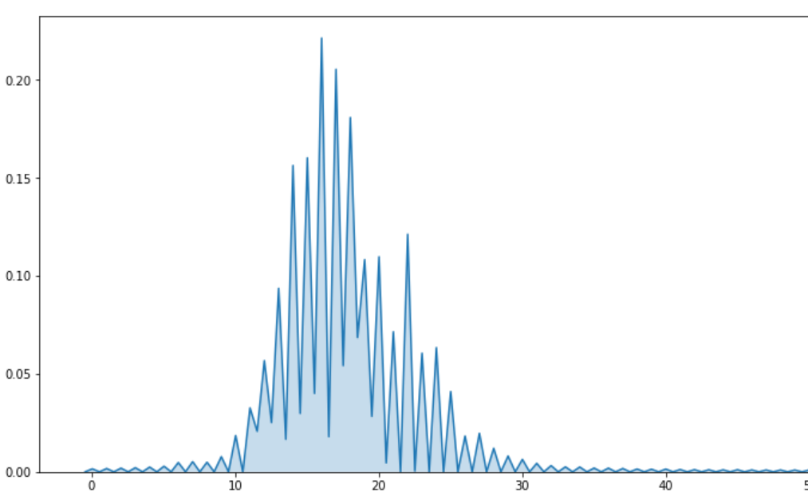
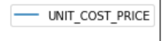
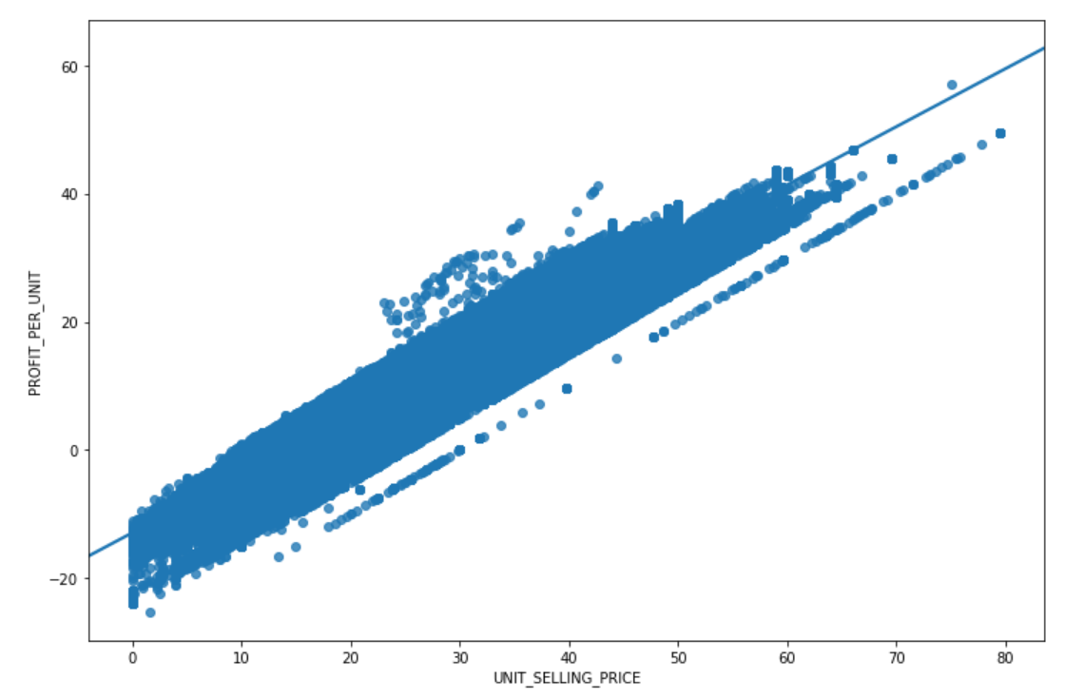
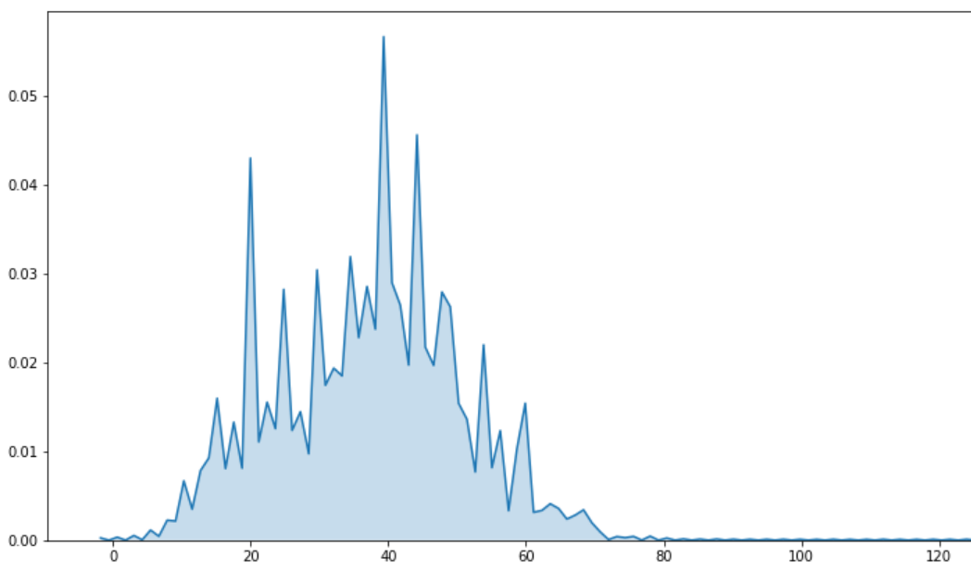
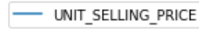
MODELLING - LINEAR REGRESSION
ENSURE ASSUMPTIONS FOR THE MODEL ARE MET
Linear relationship.
Multivariate normality.
No or little multicollinearity.
No auto-correlation.
Homoscedasticity.
LINEAR RELATIONSHIP (Replace below graph with C.P Vs S.P)
MULTI-VARIATE NORMALITY
(Normal Distribution, Goodness of Fit)

Slide 28
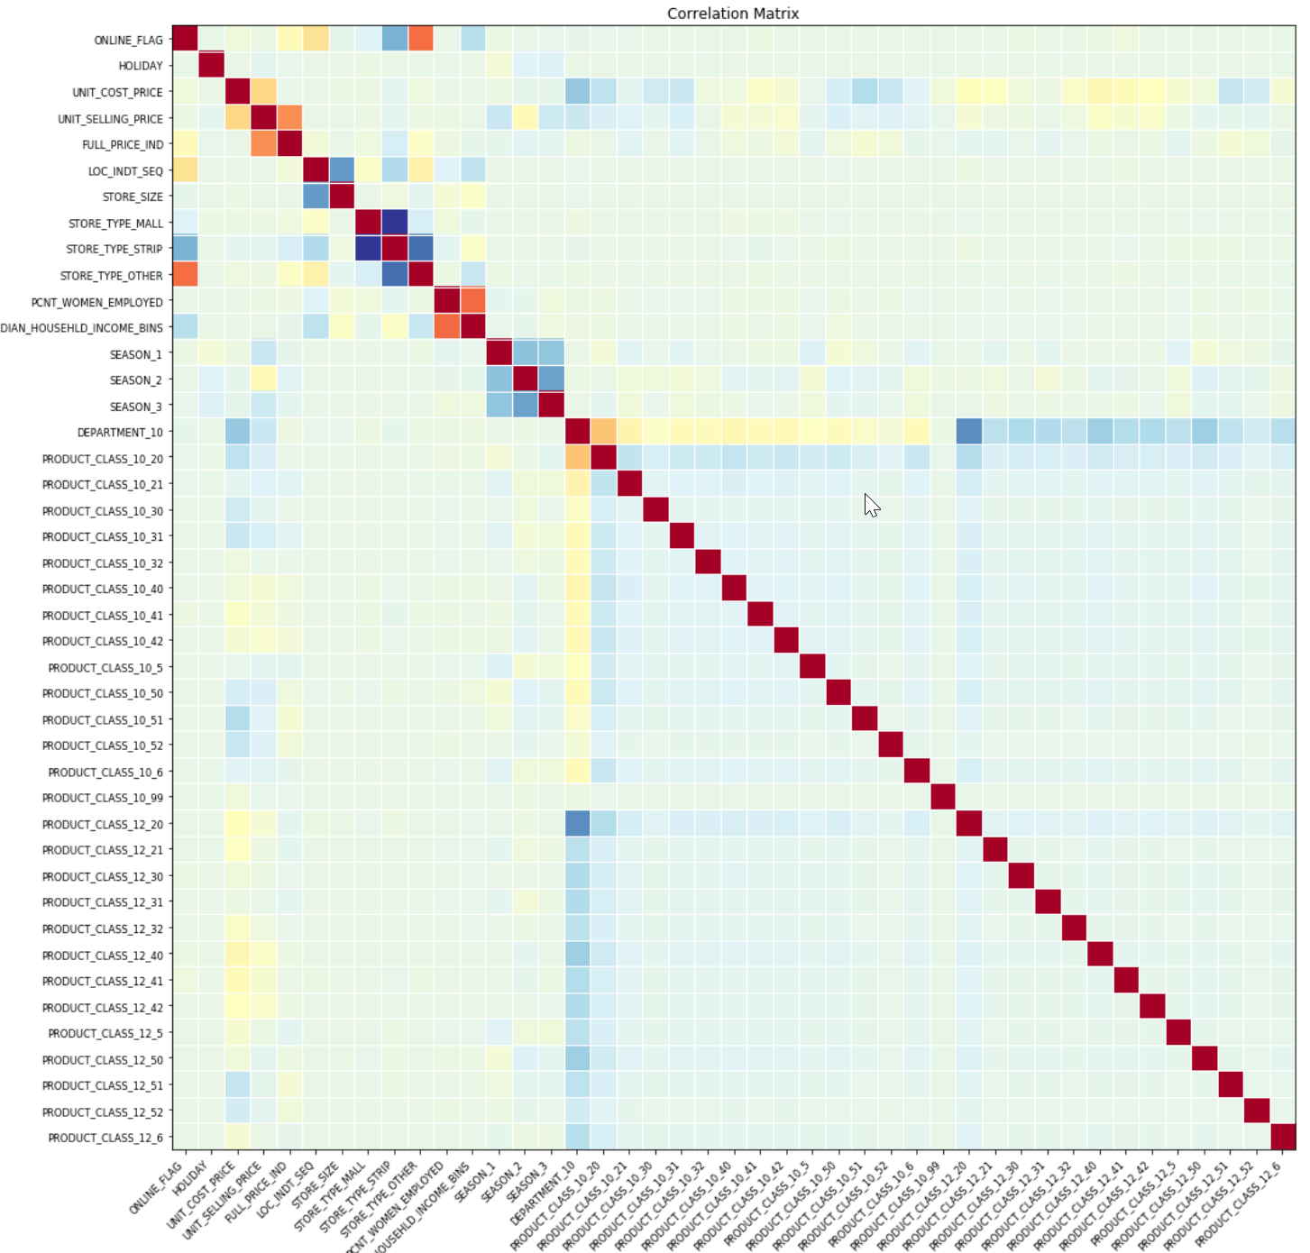
NO
MULTI COLLINEARITY

Slide 29
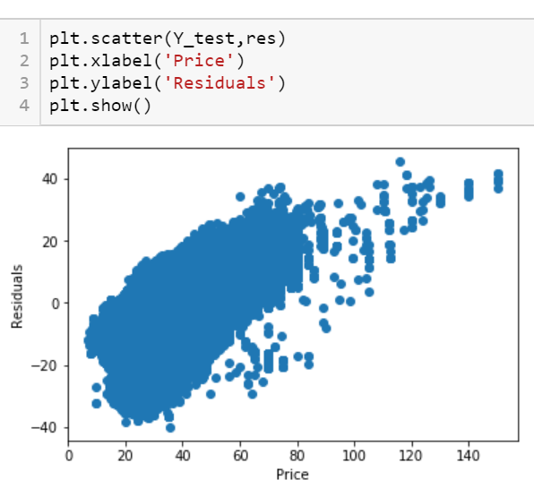
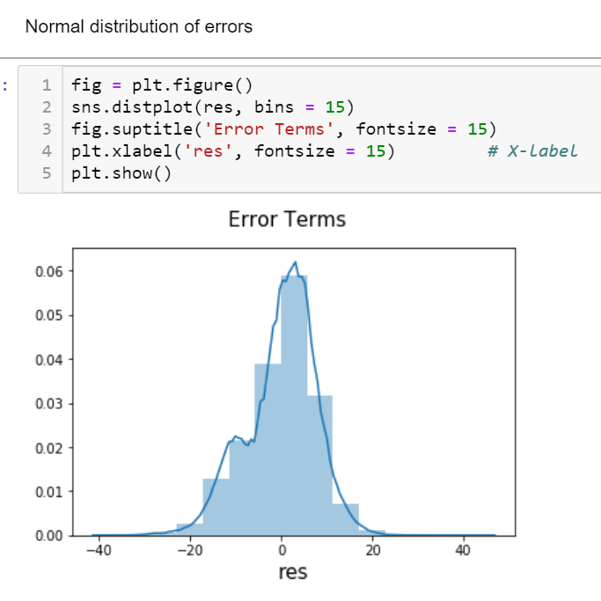
LINEAR REGRESSION - MODELLING ASSUMPTIONS (contd..)
HOMOSCEDASTICITY
NORMAL DISTRIBUTION OF ERRORS

Slide 30
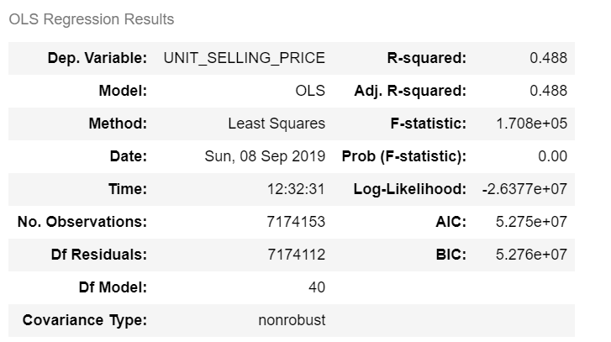
LINEAR REGRESSION - EVALUATION
R-sqrd = 0.488 (some of the variance is explained)

Slide 31
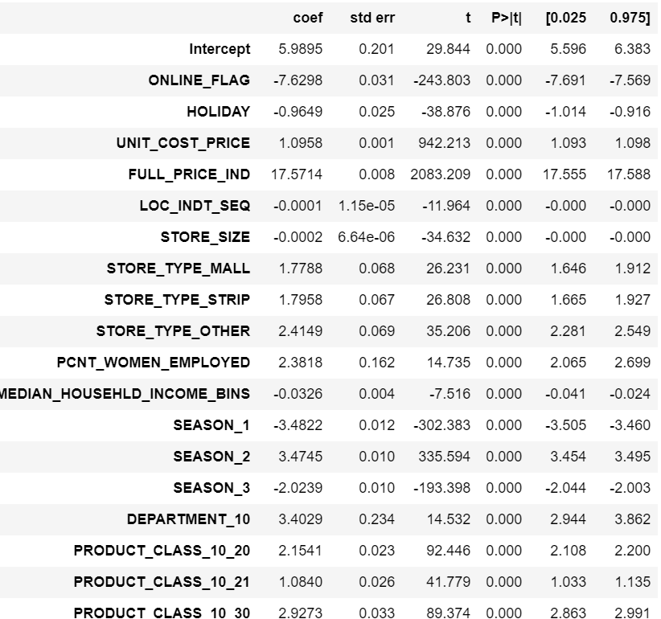
LINEAR REGRESSION - EVALUATION contd..
P-values are 0 for most feautures
Co-efficients are in wide range
Ths model is not doing good hence is
rejected

Slide 32
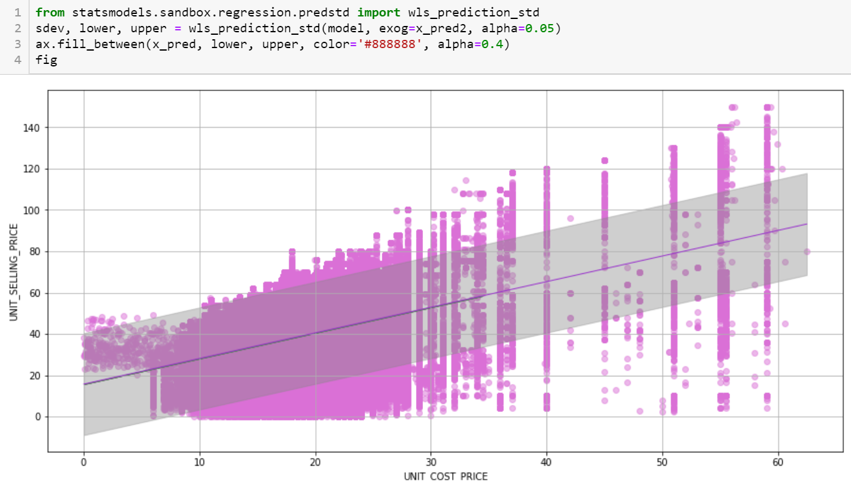
LINEAR REGRESSION - MODELLING OUTPUT - PREDICTED
PREDICTION INTERVAL WITH ONE PRODUCT AND COST PRICE AS FEATURE

Slide 33
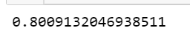
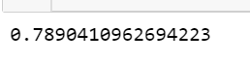
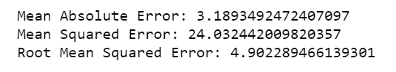
DECISION TREE REGRESSION
BETTER CAPTURES NON-LINEARITY IN DATA
EASY TO UNDERSTAND (EXPLAINABLE AI-ML)
HYPERPARAMETERS:
max_depth=20
max_features=none
ACCURACY WITH TRAIN DATA
WITH TEST DATA
ERROR METRICS

Slide 34
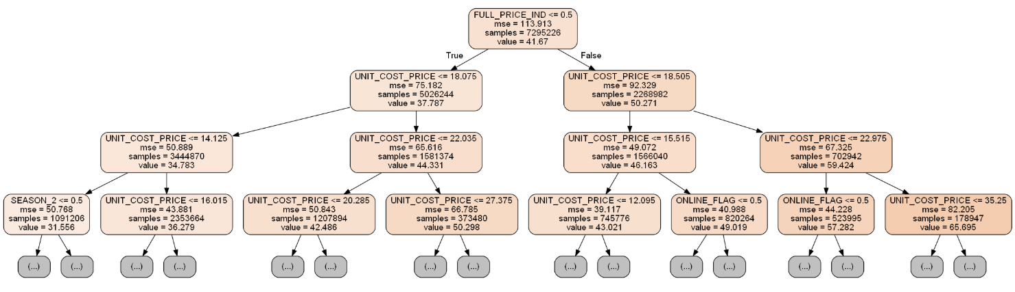
DECISION TREE REGRESSION - MODEL EVALUATION

Slide 35
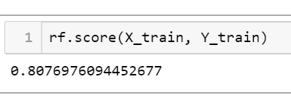
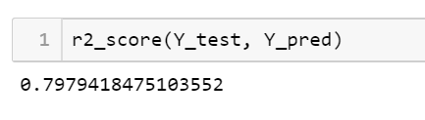
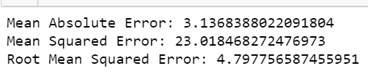
RANDOMFOREST REGRESSION
OVERCOMES THE OVERFITTING ISSUE WITH DECISIONTREES
USES ENSEMBLE LEARNING
BOTH ROWS AND COLUMNS ARE sliced
HYPERPARAMETERS:
n_estimators=50 (number of trees to be used in the forest)
max_depth=18
max_features=
WITH TRAIN DATA
WITH TEST DATA

Slide 36
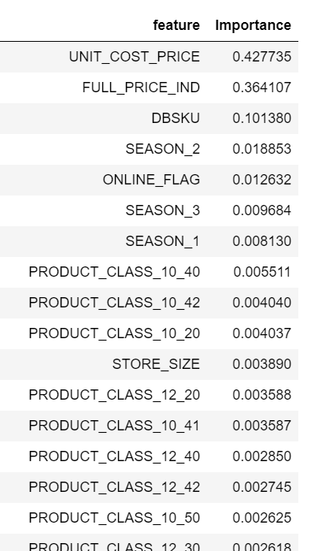
RANDOMFOREST REGRESSION - MODEL EVALUATION
FEATURE IMPORTANCE
For Sales Price Optimization, these are the features needed as inputs
Since SKU column is present, Product_class feature could be removed
RandomForest by its nature will take care of this collinearity

Slide 37
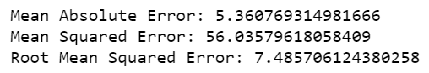
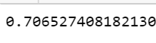
KNN REGRESSION
K-NEAREST Neighbors more closely matches the features of the test data with train data
This can be useful in this use-case as predicting price matching/clustered by SKU, Location etc would be more meaningful
HYPERPARAMETERS:
n_neighbors=4 (number of ??)
WITH TRAIN DATA
WITH TEST DATA
Note: Feature Scaling could be used to further optimize the score

Slide 38
EVALUATION METRICS COMPARISON
Model | Accuracy (Train) | Accuracy (Test) | MAE | MSE | RMSE | Complexity
Linear Regression | 0.574 | 0.574 | 6.04 | 59.07 | 7.686 | Low
Decision Tree | 0.801 | 0.789 | 3.189 | 24.03 | 4.902 | Low
Random Forest | 0.808 | 0.798 | 3.14 | 23.01 | 4.798 | High
KNN n-nbrs 4 n-nbrs 6 | 0.811 0.790 | 0.703 0.706 | 3.895 3.983 | 33.83 33.43 | 5.816 5.782 | Very High
DECISION TREE / RANDOM FOREST ARE THE RECOMMENDED MODELS
Since Random Forest already does cross-validation, separate cross-validation exercise did not seem necessary

Slide 39
SALE PRICE OPTIMIZATION
OPTIMIZE SELLING PRICE of the product (SKU/Product class+subclass)
to maximise profits (bottomline) and Sales (topline)
Price Elasticity ideally needs data on how customers react to price variations
A Demand Curve helps analyse the maximum price at which demand is not impacted (the price customer accepts without impacting Quantities Sold)
We will use existing data to draw demand curve to find range of potential Sales Price to optimize revenue/profits
Based on the range, existing Sales Data will be used to predict/estimate
Selling Price for a given SKU/Product subclass

Slide 40
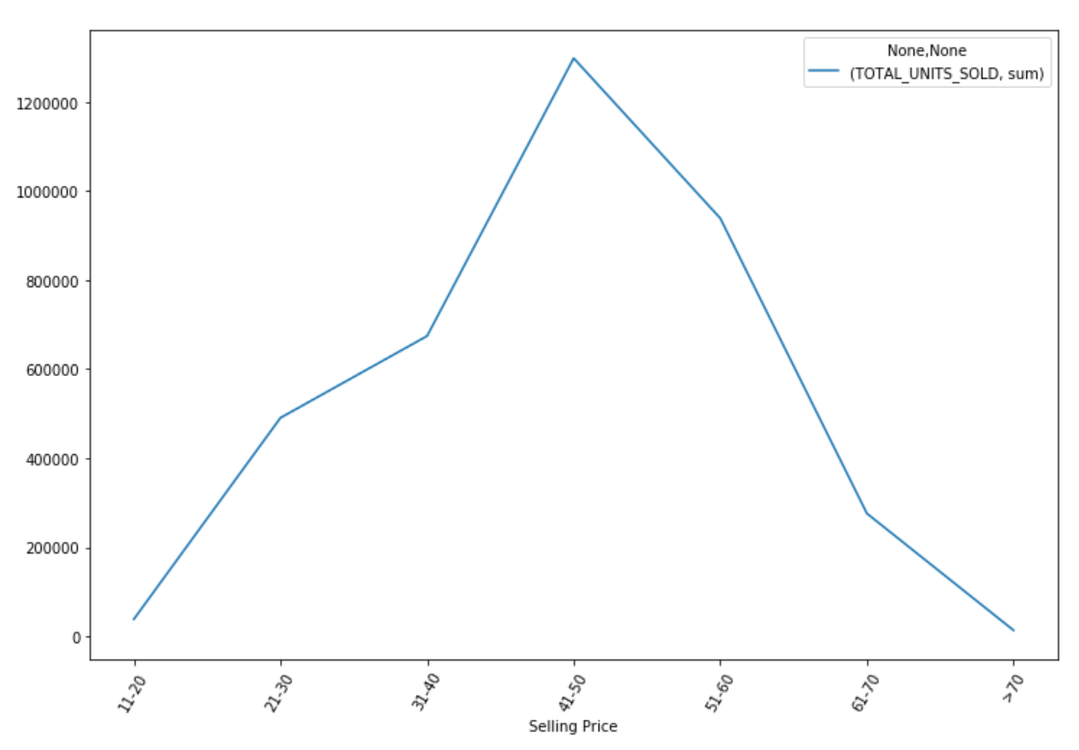
SALE PRICE OPTIMIZATION - DATA SUBSETTING
We chose popular product Dept 10, Class 2, Subclass 20
DEMAND CURVE
Demand peaks when Selling Price
is between 41 and 50
Above 50, customers are resisting
buying it
If Topline growth is the goal, use txn
data subset with Selling Price in
this range
If Bottomline Growth is the goal,
use Profit > (X)% as the data subset

Slide 41
SALE PRICE OPTIMIZATION - PRICE RECOMMENDATION
Model is trained using the desired data subset
We trained RandomForest Model
Price Recommendation step is same as prediction
User gives following inputs (which becomes input to the model)
SKU (or Product Dept, Class and Subclass)
Discounted or Full Price?
Date of Sale (or Month/Season)
Cost Price (tool can default to avg Cost Price for that product)
<fittedmodel>.predict() is run to predict the Selling Price
Error Metrics are used to determine confidence levels

Slide 42
NEXT STEPS AND FURTHER WORK
Customer Behavior Analytics
Obtain Customer data and categorize customers into “regular”, “semi-regular” and “infrequent” Use Analytics and Machine learning models to understanding purchase behaviors of these users and adjust price and discounts accordingly
Dynamic Pricing
Pricing can further be optimized by regularly adjusting the Selling Price (even on daily basis) by inputting the variables

Slide 43
Thank You!

